Slide 1
1.6.14 Geometric series

Slide 2
Outline
In this topic, we will
Examine geometric series for complex ratios
Look at some examples

Slide 3
Geometric series
Recall that for a geometric series, we had
If |r| < 1, then

Slide 4
Complex ratios
If you go back to the proof, nothing but field properties were used
Therefore, these formulas should be true for complex ratios

Slide 5
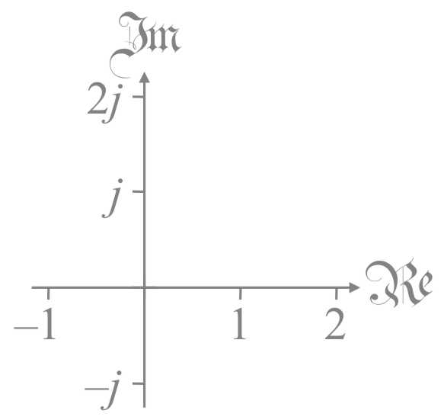
Complex ratios
You may wonder if this is correct:
You can calculate the partial sums and see this is reasonable

Slide 6
Complex ratios
Similarly,

Slide 7
Further understanding
Question:
If r is not real, will ever be real?
Answer: no, for

Slide 8
Summary
In this topic, you now
Understand the formulas for geometric series hold for any field
Saw some examples and evidence thereof

Slide 9
References
[1] https://en.wikipedia.org/wiki/Geometric_series

Slide 10
Acknowledgments
None so far.

Slide 11
Colophon
These slides were prepared using the Cambria typeface. Mathematical equations use Times New Roman, and source code is presented using Consolas. Mathematical equations are prepared in MathType by Design Science, Inc.
Examples may be formulated and checked using Maple by Maplesoft, Inc.
The photographs of flowers and a monarch butter appearing on the title slide and accenting the top of each other slide were taken at the Royal Botanical Gardens in October of 2017 by Douglas Wilhelm Harder. Please see
https://www.rbg.ca/
for more information.

Slide 12
Disclaimer
These slides are provided for the ne 112 Linear algebra for nanotechnology engineering course taught at the University of Waterloo. The material in it reflects the authors’ best judgment in light of the information available to them at the time of preparation. Any reliance on these course slides by any party for any other purpose are the responsibility of such parties. The authors accept no responsibility for damages, if any, suffered by any party as a result of decisions made or actions based on these course slides for any other purpose than that for which it was intended.

